Slide 1

SINHGAD ACADEMY OF ENGINEERING A Presentation on “QR BASED ADVANCE ATTENDANCE USING 2-STEP AUTHENTICATION”
Guided by::-
Prof. V. K. Sambhar
Presented by-
Harsh Ganesh Hiradeve (B190434277)
Ankit Bandu Kakade (B190434297)
Atharv Prakash Inkar (B190434278)
Aditya Rajendra Ekunkar(B190434263)

Slide 2
INTRODUCTION
Attendance Management Can Be Divided into Two Types Specifically, MANUAL and AUTOMATED methods.
Improvement of the manual approach of keeping attendance records.
This research is to build a system that can identify students in institutions and track their attendance.

Slide 3
Motivation
To represents an analysis of different technologies.
Improvement of system for better results for the management of attendance.
Save time and decrease work load of administration/faculty.

Slide 4

Problem Definition
To overcome the problems faced in Manual attendance system because it is time consuming and very inefficient process of recording and managing attendance.

Slide 5

LITERATURE SURVEY
NAME | AUTHOR | PUBLICATION & YEAR OF PUBLICATION | INFERENCE
AN ADAPTATION OF THE WEB BASED SYSTEM ARCHITECTURE IN THE DEVELOPMENT OF THE ONLINE ATTENDANCE SYSTEM | Mahfudzah Othman Siti Nurbaya Ismail Haslinda Noradzan | IEEE - 2013 | Module of taking attendance and save it in RDBMS
STUDENTS ATTENDANCE SYSTEM AND NOTIFICATION OF COLLEGE SUBJECT SCHEDULE BASED ON CLASSROOM USING IBEACON | Muhammad Ayat Hidayat Holong Marisi Simalango | IEEE - 2018 | 1.Doucment distribution 2.Attendance UI

Slide 6
LITERATURE SURVEY
Muhammad Ayat Hidayat , Holong Marisi Simalango :-In this paper, We require a system for tracking student attendance that is effective at gathering information rapidly. By gathering data, analysing the system, designing the system, and putting it into practise, this student attendance system is accomplished. Android and PHP programming languages were used to construct this system. The goal of this project is to develop student-facing applications for attendance tracking and class notification systems based on IBEACON.

Slide 7

SOFTWARE REQUIREMENTS
Web Browser
Java
Database(MySQL)
Eclipse(IDE)
Frontend:-HTML ,JDK 1.7,JSP
Application server:-Apache Tomcat
OS :- Windows

Slide 8

HARDWARE REQUIREMENTS
PC
2 GB RAM(min)
Intel i5/i3 processor 3.1Ghz
Hard disk space -20GB

Slide 9

PROJECT SCOPE AND FEATURES
The system will help in reducing time for taking manual attendance.
Monitoring student attendance automatically.
Tackle proxy attendance.

Slide 10

Project Timeline
Study of Algorithm
Discussion about modification
Selection of group members and allocation of project guide.
Developed model UI and researched on the QR generation algorithm specified by the reviewer in review 2.
Prepared and integrated the initial backend (i.e logging in)
Review exam 1.
Integration of all Modules
JUL
AUG
SEP
OCT
NOV
DEC
JAN
FEB
MAR
APR
Project topic discussion research paper analyzing and selection of project topic .Started working on the module 1 and UI.
And made corrections specified by the reviewer in review 1.
Completed the UI of the website and finalized the QR generation algorithm.
Started working on module 1.
!st module presentation and discussion of 2nd module
Modification of modules , Design test case for our modules
Worked on User Interface
Preperation for Conference
10

Slide 11
ASSUMPTION AND DEPENDENCIES
Assuming that all the students have compatible smartphones.
Assuming all Parents/guardians should enroll their correct contact details.

Slide 12
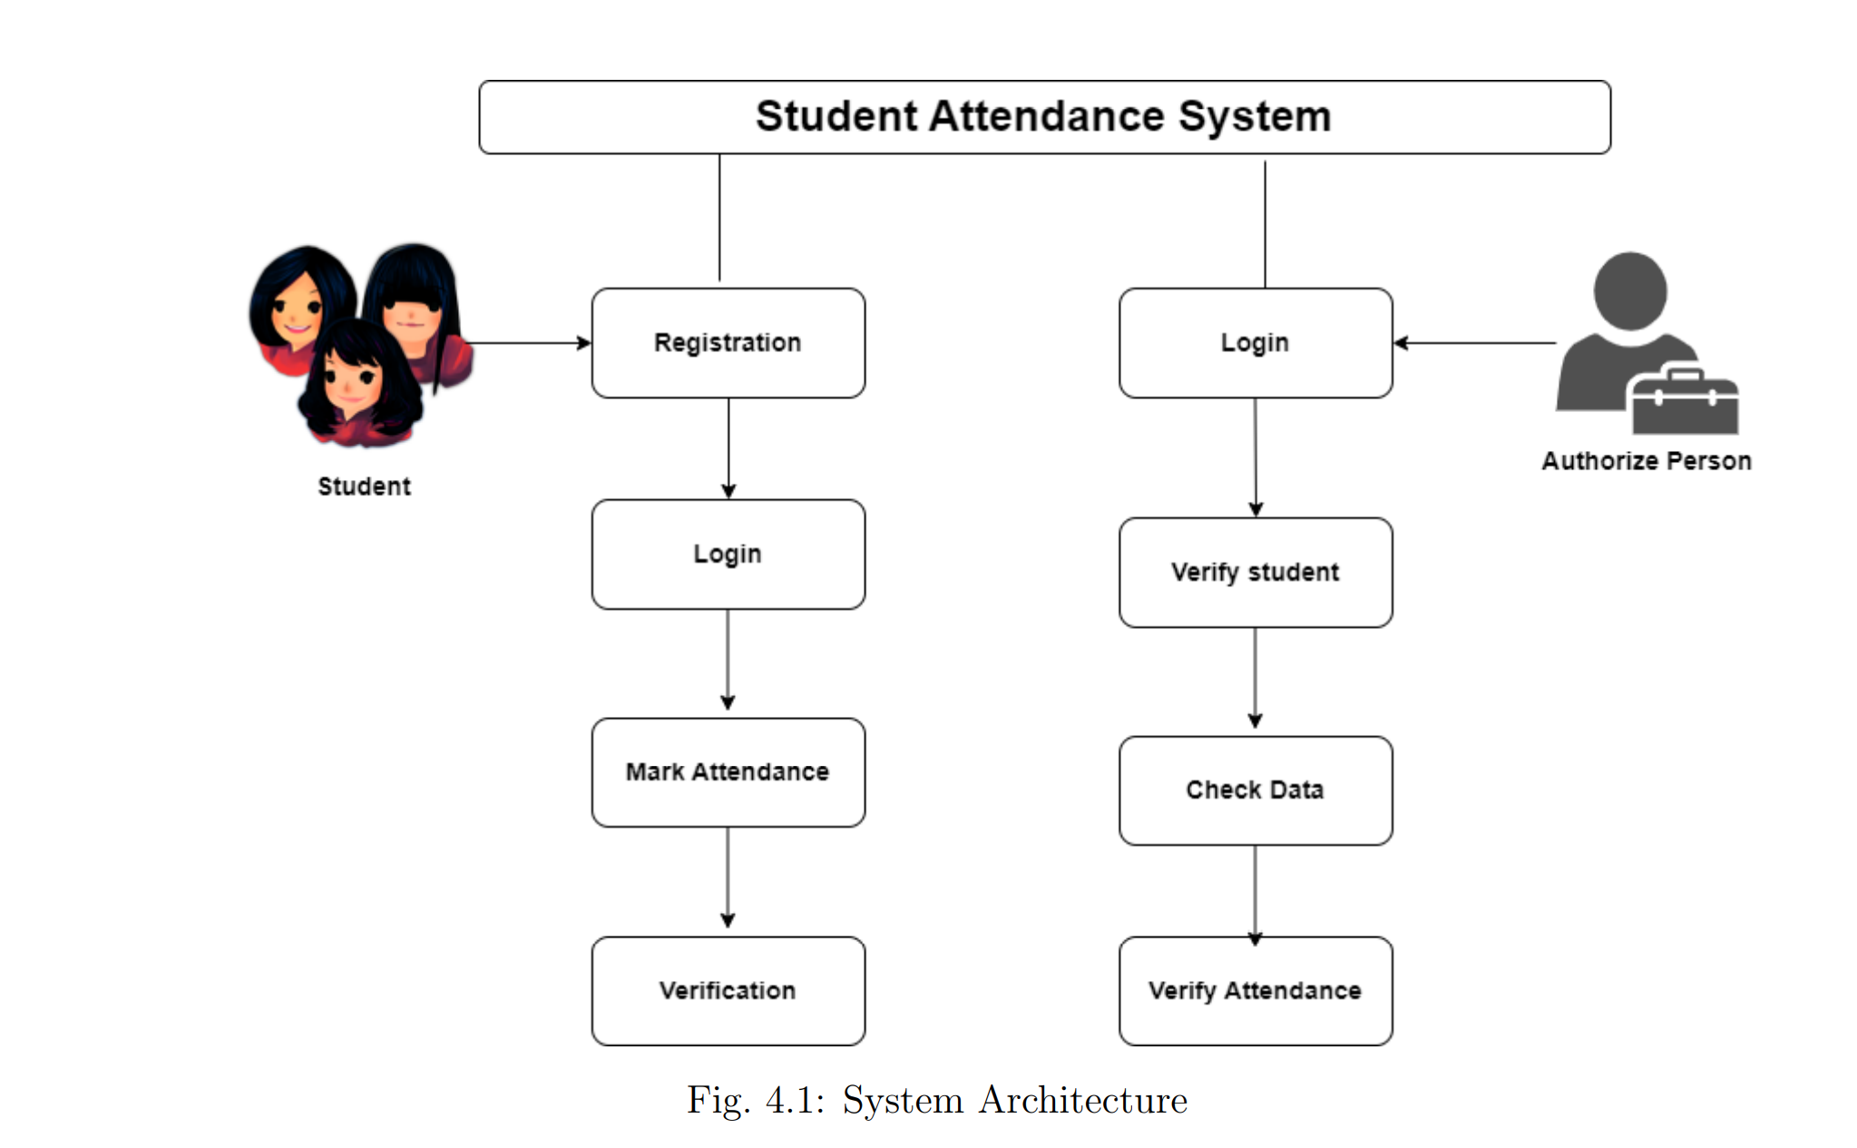

ARCHITECTURE

Slide 13
Algorithm
QR generation algorithm
Bitmatrix algorithm using Zxing(google api)

Slide 14
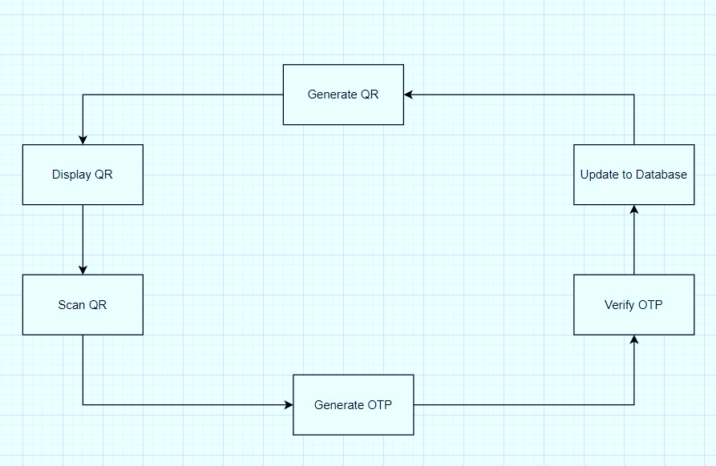

DATA FLOW DIAGRAM
0

Slide 15
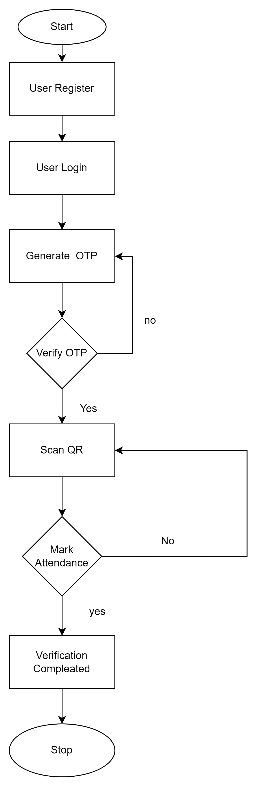
DATA FLOW DIAGRAM
1

Slide 16
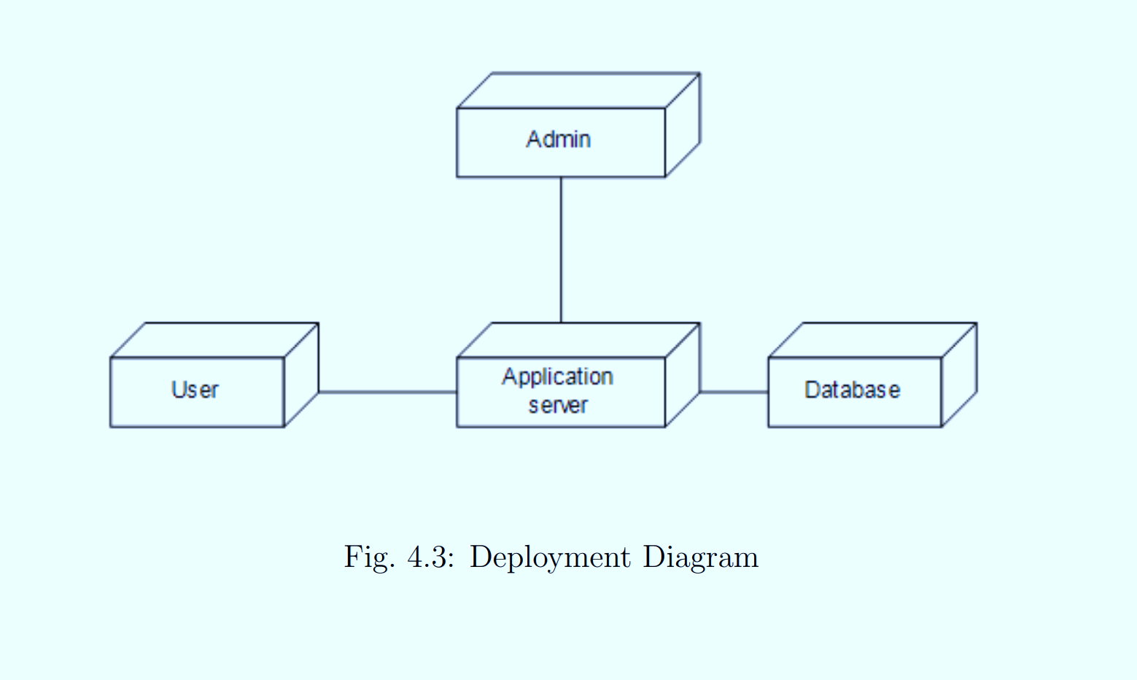

UML DIAGRAMS

Slide 17
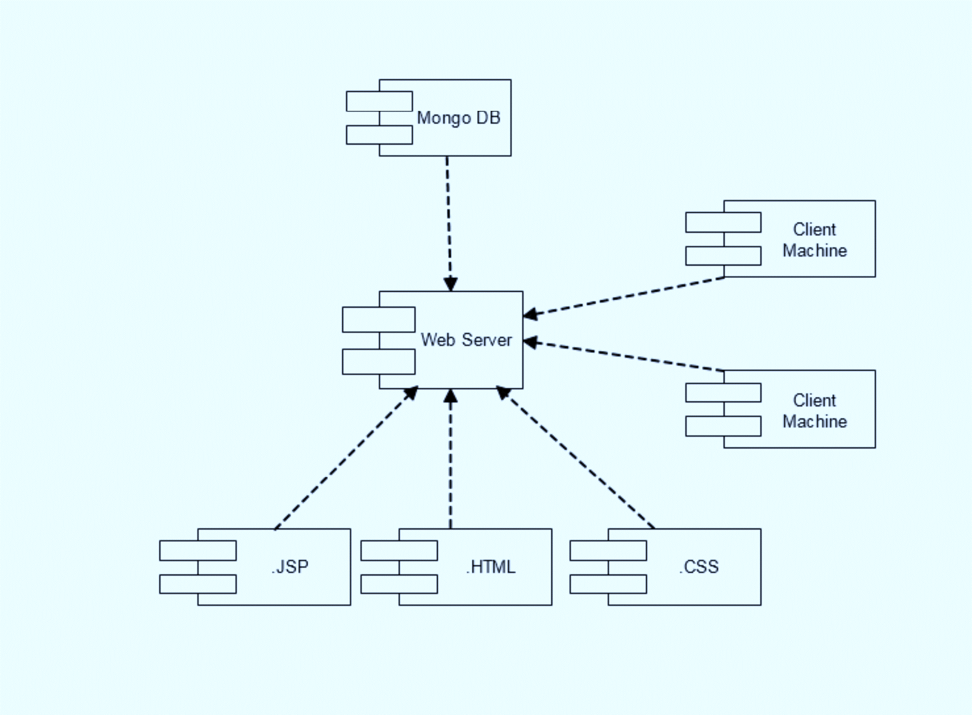
UML DIAGRAMS

Slide 18

FUTURE SCOPE
It can be multi authorized with the help of Face cam and fingerprint.
It can bind with Mobile Applications with all OS.
It can be integrated with network hotspot for a particular room.

Slide 19

REFERENCES
Muhammad Ayat Hidayat, HolongMarisiSimalango,”Students attendance system and Notification of college subject Schedule based on classroom 1. Muhammad Ayat Hidayat, Holong Marisi Simalango,”Students attendance system and Notification of college subject Schedule based on classroom using Ibeacon”, 2018 3rd International Conference on Information Technology, Information Systems and Electrical Engineering(ICITISEE), Yogyakarta, Indonesia, 978-1-5386-7082-8/18/.
Dr.Nkolika O. Nwazor, Mumuni M. Olusolape,”Cloud based Attendance Management and Information System”,(IJERT)ISSN: 2278-0181, Vol. 10 Issue 09, September-2021.
FawazAlassery, member IEEE,”A Smart Classroom of Wireless Sensor Networks for Students Time Attendance System”,2019 IEEE Integrated STEM Education Conference (ISEC).
NandgopalDevnath,NitinPasi,”QR Code Based Smart Attendance System”, International Journal of Smart Business and TechnologyVol. 5, No. 1, (2017), pp.1-10. Ibeacon”, 2018 3rd International Conference on Information Technology, Information Systems and Electrical Engineering(ICITISEE), Yogyakarta, Indonesia, 978-1-5386-7082-8/18/. 2. Dr.Nkolika O. Nwazor, Mumuni M. Olusolape,”Cloud based Attendance Management andInformation System”,(IJERT)ISSN: 2278-0181, Vol. 10 Issue 09, September-2021. 3. FawazAlassery, member IEEE,”A Smart Classroom of Wireless Sensor Networks for Students Time Attendance System”,2019 IEEE Integrated STEM Education Conference (ISEC). 4. NandgopalDevnath,NitinPasi,”QR Code Based Smart Attendance System”, International Journal of Smart Business and TechnologyVol. 5, No. 1, (2017), pp.1-10.

Slide 20
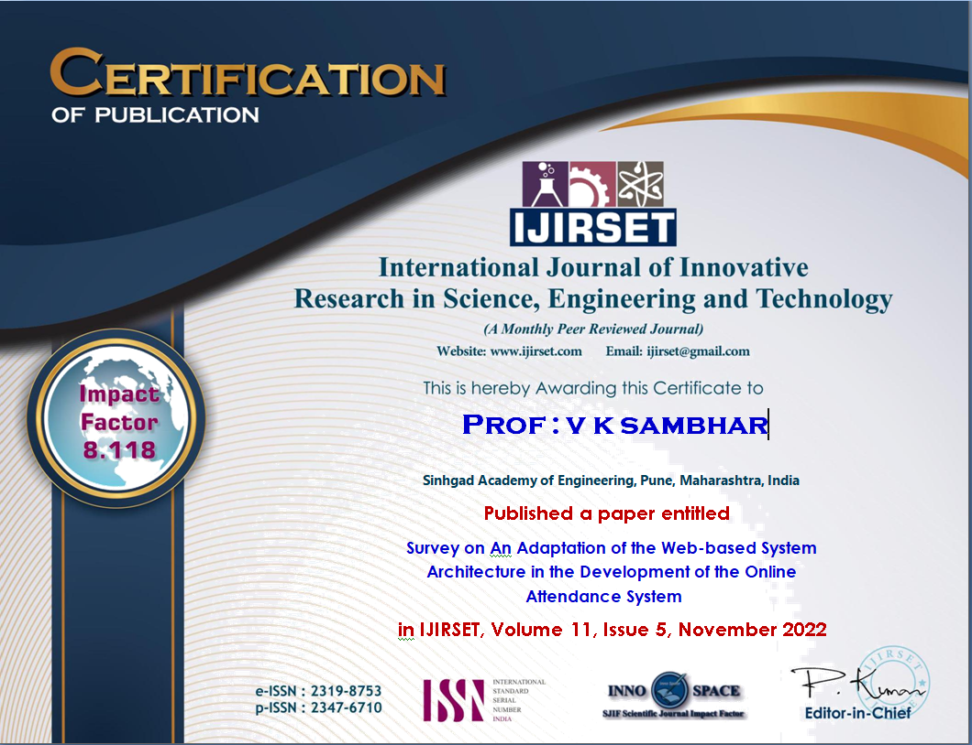


SURVEY PAPER PUBLICATION CERTIFICATE

Slide 21
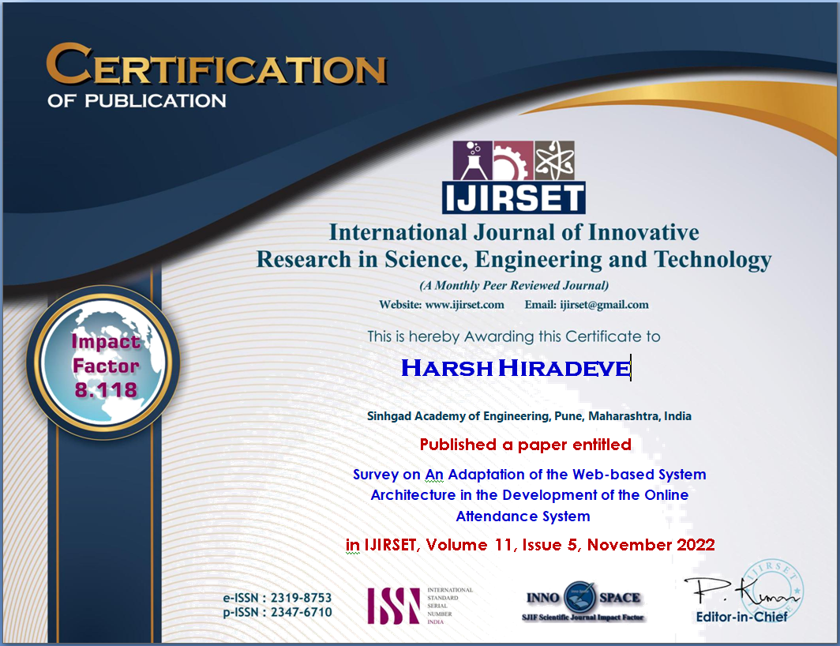
SURVEY PAPER PUBLICATION CERTIFICATE

Slide 22
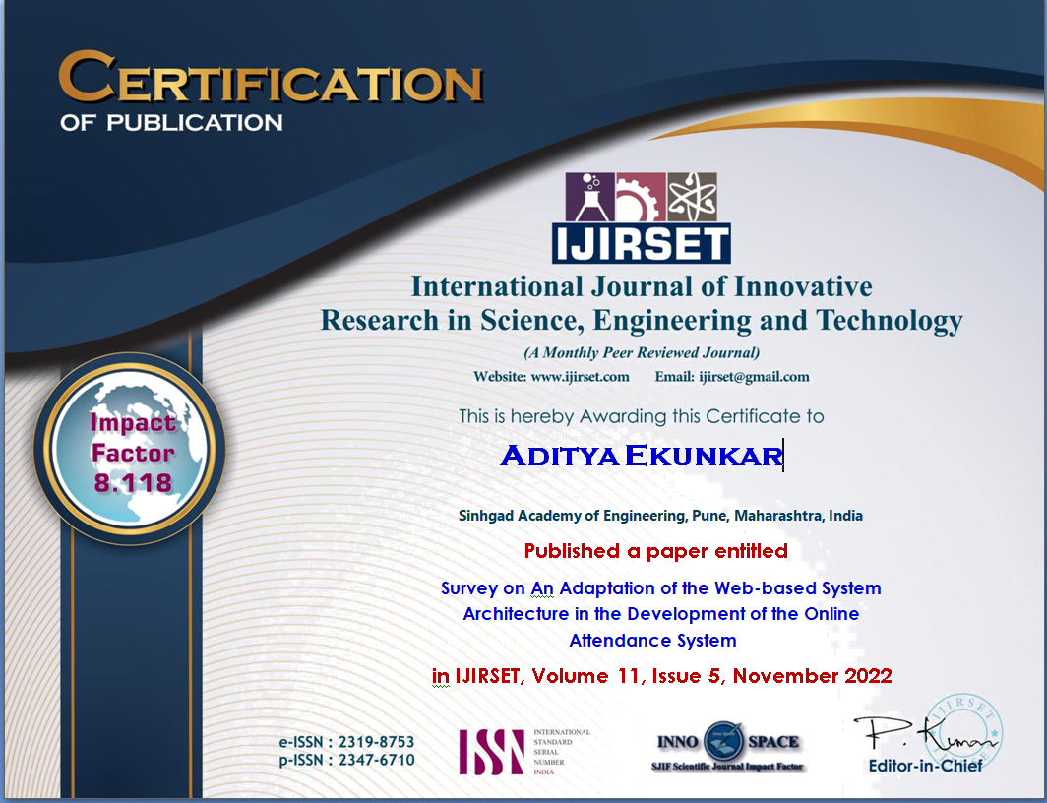
SURVEY PAPER PUBLICATION CERTIFICATE

Slide 23
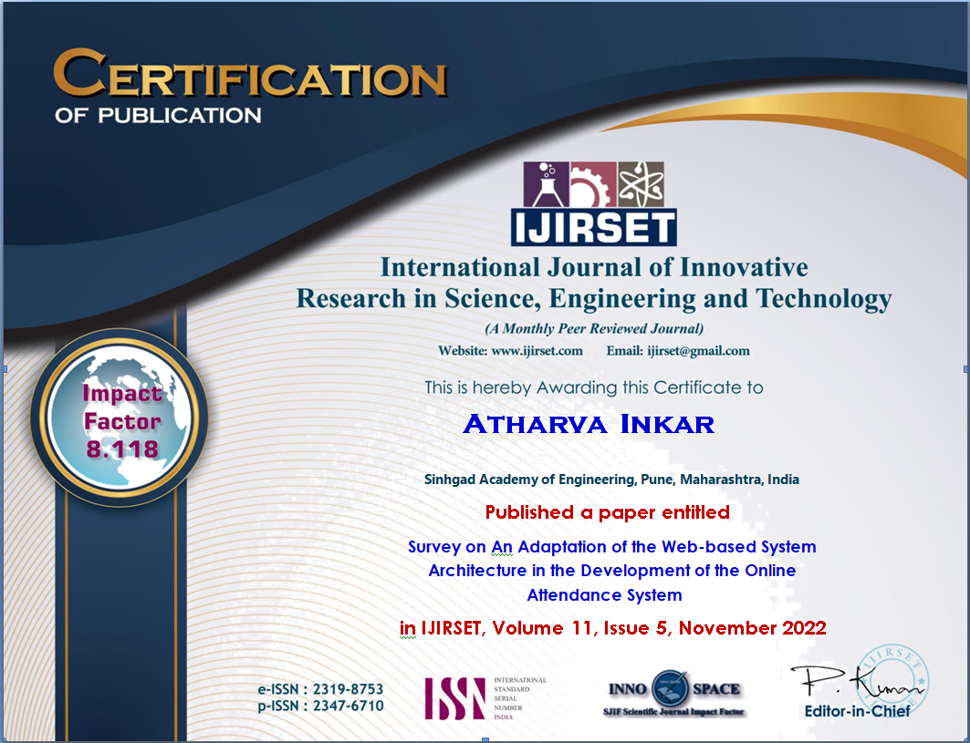
SURVEY PAPER PUBLICATION CERTIFICATE

Slide 24
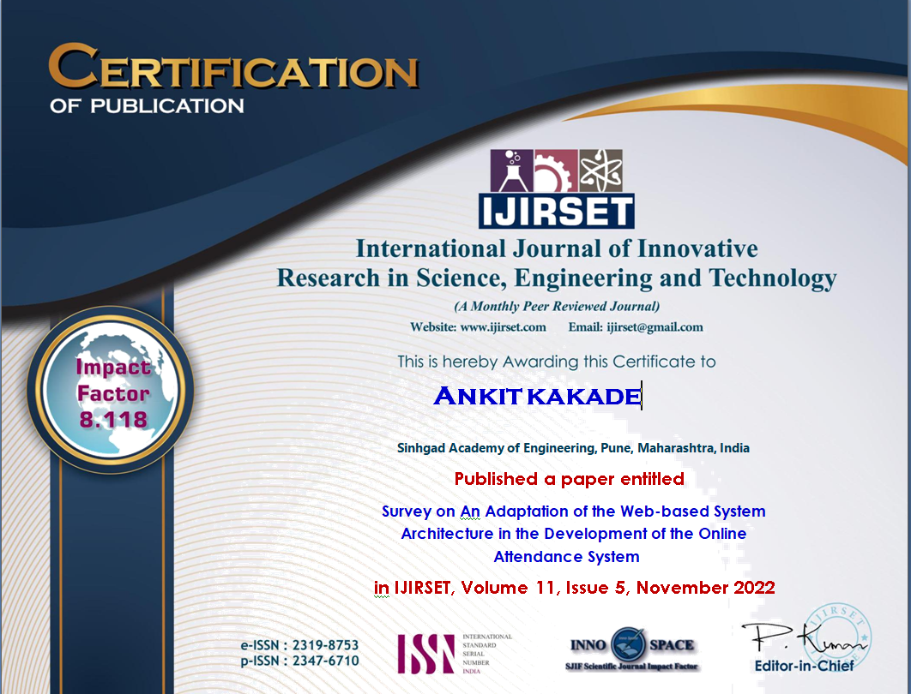
SURVEY PAPER PUBLICATION CERTIFICATE

Slide 25
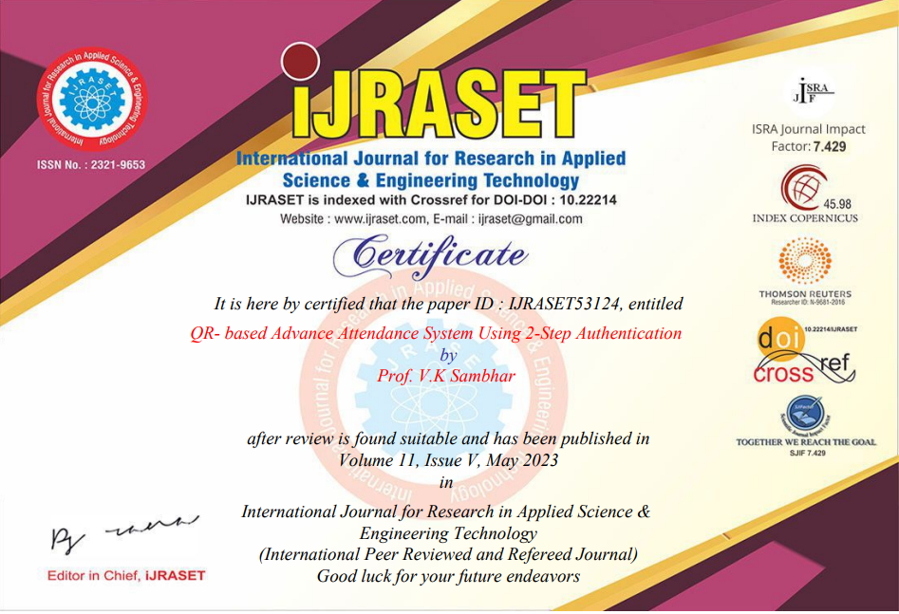

Slide 26
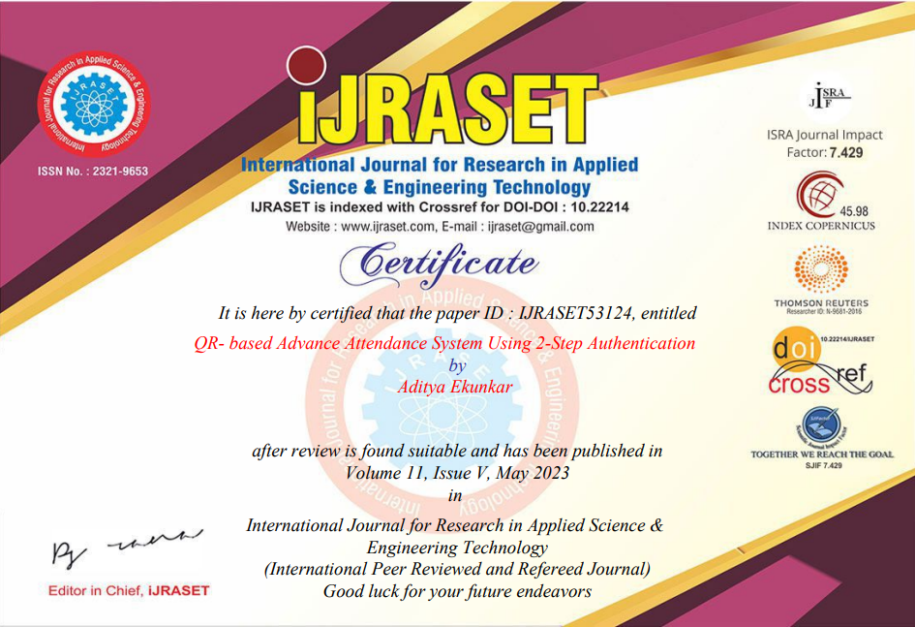

Slide 27


Slide 28


Slide 29
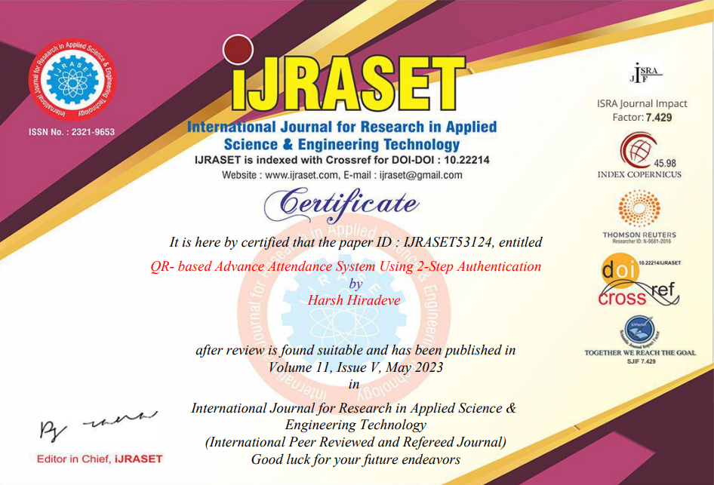

Slide 30

THANK YOU

